Slide 1
WIFI TALKING ROBOT
The Wi-Fi talking robot is a new technologic
advancement in the field of robotics.This robotic system capability to connect to the internet through a Wi-Fi network and interact with users

Slide 2
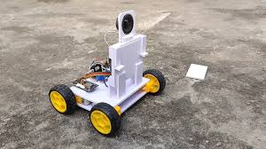
OBJECTIVE OF WIFI TALKING ROBOT:
The primary aim of a Wi-Fi talking robot project is to create a robotic system that can interact with users through speech and be remotely controlled via Wi-Fi, demonstrating practical applications in areas like home automation, customer service, and education.
This type of robot allows users to control its movements and sometimes even gather data through a user interface on a smartphone

Slide 3
COMPONENTS
01
NODEMCU
02
ESP8266 MICROCONTROLLER
TG113
03
BLUETOOTH AMPLIFIER BOARD
L298N
MOTOR DRIVER MODULE

Slide 4
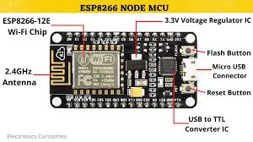
NODEMCU(ESP8266 MICROCONTROLLER)
The NodeMCU is an open-source development board and firmware based on
the ESP8266 Wi-Fi module. It is widely used for IoT (Internet of Things) applications due to
its low cost, built-in Wi-Fi,and ease of programming with Lua or Arduino IDE.
Microcontroller: ESP8266 (or ESP-12E module)
Wi-Fi Connectivity: Supports 802.11 b/g/n
Programming Languages: Lua, Arduino C++, MicroPython
Digital I/O Pins: Typically 11 GPIOs, PWM, I²C, SPI, ADC
Analog Input: 1(ADC0,Max 3.3v)
Flash Memory: 4MB
Operating Voltage: 3.3V
Clock Speed: 80MHz/160MHz
USB Interface: Built-in CP2102/CH340G USB-to-Serial converter

Slide 5
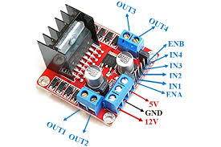
L298N MOTOR DRIVER MODULE
The L298N is a dual H-Bridge motor driver module. It lets you control the direction
and speed of two DC motors, or one stepper motor using microcontrollers like Arduino,
NodeMCU, or Raspberry Pi.
Microcontrollers cannot supply enough current to drive motors directly. L298N acts as a bridge between the microcontroller and the motors, safely supplying power and control.
Power Pins:
VCC – Motor power supply (5V to 35V)
GND – Ground
5V – Output from the onboard 5V regulator
Control Pins:
IN1, IN2 – Control Motor A direction
IN3, IN4 – Control Motor B direction
ENA – Enable/speed control for Motor A
ENB – Enable/speed control for Motor B
Output Pins (to Motors):
OUT1 & OUT2 – Connect to Motor A
OUT3 & OUT4 – Connect to Motor B

Slide 6
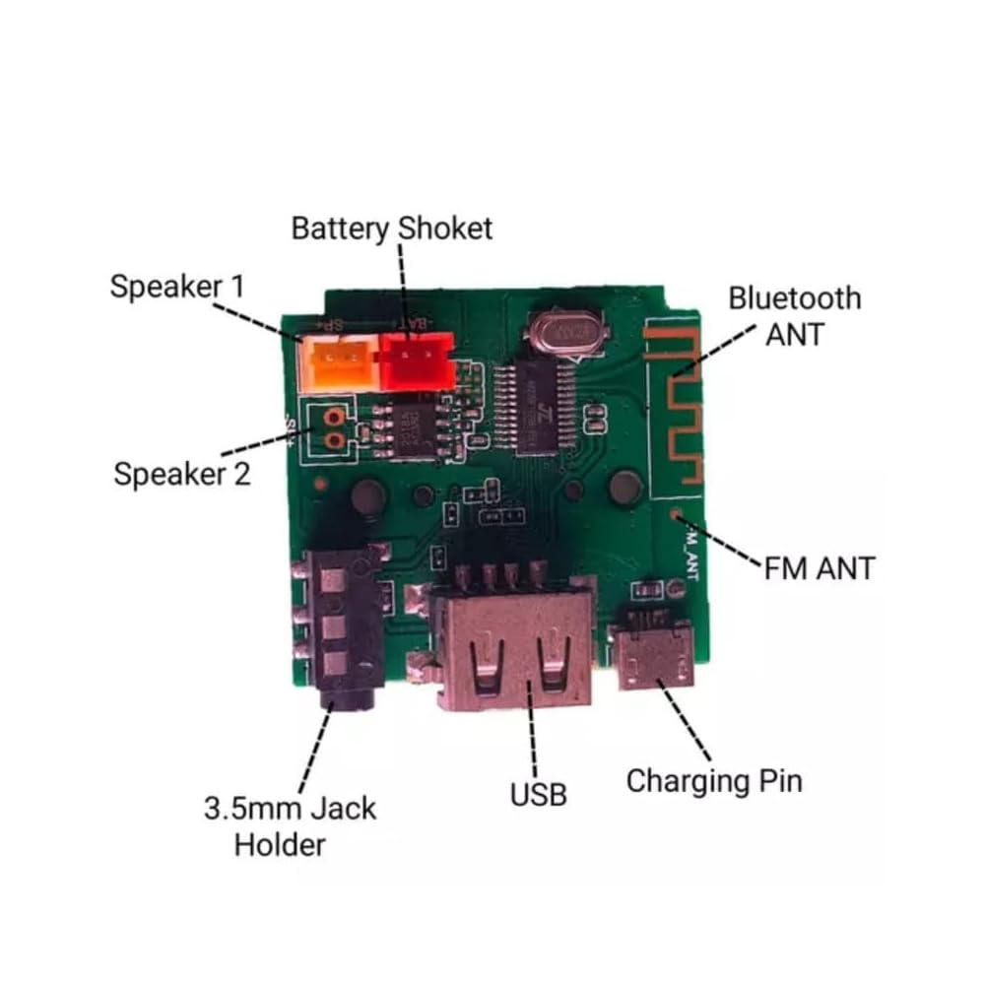
TG113 BLUETOOTH AMPLIFIER BOARD
The TG113 Bluetooth speaker contains a built-in amplifier and Bluetooth audio module, typically using:
Bluetooth 4.2/5.0 for wireless connectivity
Class-D amplifier chip for efficient audio output
Power output: Usually around 5W × 2 (stereo)
Battery-powered: Rechargeable via Micro-USB
Aux Input: Supports 3.5mm jack for wired audio
Operating Voltage: 3.6V-7.2V DC
Audio Formats: Supports MP3, WMA, and WAV formats
Amplifier: Has a small amplifier that can drive speakers
Bluetooth: Has built-in Bluetooth for wireless music streaming and hands-free calls
Additional Features: FM radio, USB, SD-card slot, AUX input, and a built-in microphone for recording purposes

Slide 7
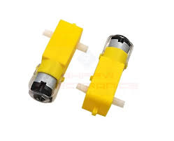
DUAL-SHAFT BO MOTORS
A dual-shaft BO (Brushless) motor is a type of electric motor that has two separate
shafts, each with its own set of magnetic poles and windings.
Electrical Specifications:
Voltage: 12V, 24V, or 4V DC
Current: 1A, 2A, 5A, or 10A
Power: 10W, 20W, 50W, or 100W
Efficiency: 80%, 85%, or 90%
Control Specifications:
Control Mode: PWM, analog, or digital
Control Interface: UART, SPI, I2C, or CAN
Encoder: Optional, with 1000, 2000, or 3600 CPR
Performance Specifications:
Speed Range: 1000 RPM, 2000 RPM, 3000 RPM, or 4000 RPM
Torque: 0.1 Nm, 0.5 Nm, 1 Nm, or 2 Nm
Acceleration: 1000 RPM/s, 2000 RPM/s, 3000 RPM/s, or 4000 RPM/s

Slide 8
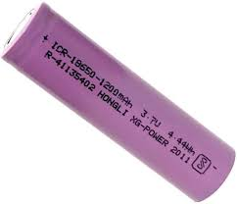
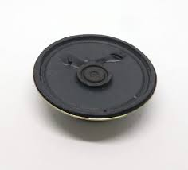
LITHIUM ION BATTERY AND SPEAKER
Lithium-ion (Li-ion) batteries are a type of rechargeable battery that has become widely
used in portable electronics, electric vehicles, and renewable energy systems.
Electrical Specifications:
Nominal Voltage: 3.7V, 7.4V, 11.1V, or 12V
Capacity: 100mAh, 200mAh, 500mAh, 1000mAh, or higher
Charging Voltage: 4.2V, 8.4V, or 12.6V
Discharging Voltage: 2.75V, 5.5V, or 10.5V
Internal Resistance: 10mΩ, 20mΩ, or 50mΩ
8E/O.5W Speaker:
Electrical Characteristics:
Impedance: 8Ω
Power Rating: 0.5W
Voltage Rating: 1.5V - 3V
Current Rating: 62.5mA - 125mA

Slide 9
WORKING MECHANISM
Software Components:
Microcontroller Firmware: The program running on the microcontroller, responsible
for receiving commands, controlling the motors, and interacting with the WiFi module.
WiFi Library: A software library that provides WiFi connectivity and communication
functionality to the microcontroller.
Remote Control App: A mobile or web application that sends commands to the WiFi
controlled car,allowing users to remotely control the vehicle.
Working Mechanism:
Connection Establishment: The WiFi-controlled car connects to a WiFi network using
the WiFi module.
Command Reception: The microcontroller receives commands from the remote control
app through the WiFi connection.
Command Processing: The microcontroller processes the received commands,
determining the desired action (e.g., move forward, turn left, stop).
Motor Control: The microcontroller sends signals to the motor driver, which controls the
speed and direction of the DC motors.

Slide 10
Movement: The DC motors propel the car forward, backward, or turn it left or right,
depending on the received commands.
Communication Protocol:
The WiFi-controlled car uses a communication protocol to exchange data with the remote
control app.Common protocols include:
HTTP: Hypertext Transfer Protocol, used for web-based communication.
MQTT: Message Queuing Telemetry Transport, a lightweight messaging protocol.
TCP/IP: Transmission Control Protocol/Internet Protocol, a suite of communication protocols.
Bluetooth Activation:
Once powered, the board boots the Tg113 Bluetooth module.You’ll hear a voice prompt or
beep.A Bluetooth LED starts flashing, indicating it's in pairing mode.
On your phone or computer, search for available Bluetooth devices.You should see
something like "TG113" appear.Tap to pair.
Play audio from your device.The board receives the audio over Bluetooth and sends the
signal to the amplifier.The amplified signal drives the speaker, and you hear sound.

Slide 11
PIN CONNECTIONS
Motor Driver to NodeMCU Connections:
ENA (Enable A) on the L298N should be connected to D5 (GPIO14) on the NodeMCU.
This pin controls the speed of the left motor using PWM.
IN1 on the L298N should be connected to D8 (GPIO15) on the NodeMCU.This is one of
the direction control pins for the left motor.
IN2 on the L298N should be connected to D7 (GPIO13) on the NodeMCU.This is the other
direction control pin for the left motor.
IN3 on the L298N should be connected to D4 (GPIO2) on the NodeMCU.This is one of the
direction control pins for the right motor.
IN4 on the L298N should be connected to D3 (GPIO0) on the NodeMCU.This is the other
direction control pin for the right motor.
ENB (Enable B) on the L298N should be connected to D6 (GPIO12) on the NodeMCU.This
pin controls the speed of the right motor using PWM.

Slide 12
Power Connections:
Connect the 5V pin of the NodeMCU to the 5V logic pin of the L298N (if you're powering the motors separately).
Connect the GND of the NodeMCU to the GND of the L298N. This common ground is essential for the circuit to work correctly.
Power the motors by connecting an external battery (e.g., 6V–12V) to the 12V input on the L298N. Make sure the jumper on the ENA/ENB pins is removed if you're using PWM from NodeMCU.
TG113 Board Pin Descriptions:
Battery Connection (B+ and B-)
B+: Battery positive terminal to the red wire of the Li-ion battery
B-: Battery negative terminal to black wire of the Li-ion battery
These connect directly to the 3.7V Li-ion battery.
Speaker Connections
SPK+ to the positive terminal of the speaker
SPK- to the negative terminal of the speaker

Slide 13
pinMode(IN_3, OUTPUT);
pinMode(IN_4, OUTPUT);
Serial.begin(115200);
//Connecting WiFi
WiFi.mode(WIFI_AP);
WiFi.softAP(ssid);
IPAddress myIP = WiFi.softAPIP();
Serial.print("AP IP address: ");
Serial.println(myIP);
//Starting WEB-server
server.on ( "/", HTTP_handleRoot );
server.onNotFound ( HTTP_handleRoot );
server.begin(); }
void goAhead(){
digitalWrite(IN_1, LOW);
digitalWrite(IN_2, HIGH);
analogWrite(ENA, speed);
digitalWrite(IN_3, LOW);
digitalWrite(IN_4, HIGH);
analogWrite(ENB, speedCar); }
SOURCE CODE:
#define ENA 14
#define ENB 12
#define IN_1 15
#define IN_2 13
#define IN_3 2
#define IN_4 0
#include <ESP8266WiFi.h>
#include <WiFiClient.h>
#include <ESP8266WebServer.h>
String command;
int speedCar = 800;
int speed_Coeff = 3;
const char* ssid = "WIFI CAR";
ESP8266WebServer server(80);
void setup() {
pinMode(ENA, OUTPUT);
pinMode(ENB, OUTPUT);
pinMode(IN_1, OUTPUT);
pinMode(IN_2, OUTPUT);

Slide 14
void goBack(){
digitalWrite(IN_1, HIGH);
digitalWrite(IN_2, LOW);
analogWrite(ENA, speedCar);
digitalWrite(IN_3, HIGH);
digitalWrite(IN_4, LOW);
analogWrite(ENB, speedCar); }
void goRight(){
digitalWrite(IN_1, HIGH);
digitalWrite(IN_2, LOW);
analogWrite(ENA, speedCar);
digitalWrite(IN_3, LOW);
digitalWrite(IN_4, HIGH);
analogWrite(ENB, speedCar);}
void goLeft(){
digitalWrite(IN_1, LOW);
digitalWrite(IN_2, HIGH);
analogWrite(ENA, speedCar);
digitalWrite(IN_3, HIGH);
digitalWrite(IN_4, LOW);
analogWrite(ENB, speedCar);}
void goAheadRight(){
digitalWrite(IN_1, LOW);
digitalWrite(IN_2, HIGH);
analogWrite(ENA, speedCar/speed_Coeff);
digitalWrite(IN_3, LOW);
digitalWrite(IN_4, HIGH);
analogWrite(ENB, speedCar); }
void goAheadLeft(){
digitalWrite(IN_1, LOW);
digitalWrite(IN_2, HIGH);
analogWrite(ENA, speedCar);
digitalWrite(IN_3, LOW);
digitalWrite(IN_4, HIGH);
analogWrite(ENB, speedCar/speed_Coeff); }
void goBackRight(){
digitalWrite(IN_1, HIGH);
digitalWrite(IN_2, LOW);
analogWrite(ENA, speedCar/speed_Coeff);
digitalWrite(IN_3, HIGH);
digitalWrite(IN_4, LOW);
analogWrite(ENB, speedCar); }

Slide 15
void goBackLeft(){
digitalWrite(IN_1, HIGH);
digitalWrite(IN_2, LOW);
analogWrite(ENA, speedCar);
digitalWrite(IN_3, HIGH);
digitalWrite(IN_4, LOW);
analogWrite(ENB, speedCar/speed_Coeff); }
void stopRobot(){
digitalWrite(IN_1, LOW);
digitalWrite(IN_2, LOW);
analogWrite(ENA, speedCar);
digitalWrite(IN_3, LOW);
digitalWrite(IN_4, LOW);
analogWrite(ENB, speedCar); }
void loop() {
server.handleClient();
command = server.arg("State");
if (command == "F") goAhead();
else if (command == "B") goBack();
else if (command == "L") goLeft();
else if (command == "R") goRight();
else if (command == "I") goAheadRight();
else if (command == "G") goAheadLeft();
else if (command == "J") goBackRight();
else if (command == "H") goBackLeft();
else if (command == "0") speedCar = 400;
else if (command == "1") speedCar = 470;
else if (command == "2") speedCar = 540;
else if (command == "3") speedCar = 610;
else if (command == "4") speedCar = 680;
else if (command == "5") speedCar = 750;
else if (command == "6") speedCar = 820;
else if (command == "7") speedCar = 890;
else if (command == "8") speedCar = 960;
else if (command == "9") speedCar = 1023;
else if (command == "S") stopRobot();}
void HTTP_handleRoot(void) {
if( server.hasArg("State") ){
Serial.println(server.arg("State"));
}
server.send ( 200, "text/html", "" );
delay(1);
}

Slide 16
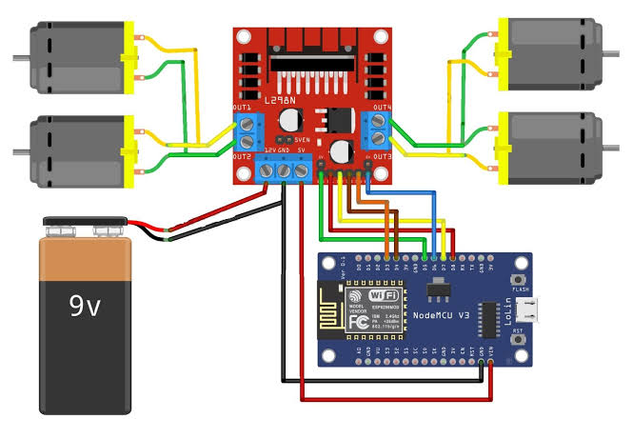
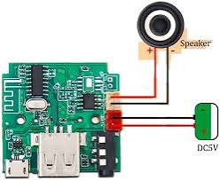
CIRCUIT DIAGRAM

Slide 17
THANK YOUU!!
THIS CONCLUDES OUR PROJECT PRESENTATION.
THIS WAS A COLLABORATIVE EFFORT BY OUR TEAM:
S.NAGI REDDY(O210096)
K.MAHESH CHANDRA(O210108)
G.HEMANTH KUMAR(O210120)
G.NANDINI(O210123)
CH.TANISHKA(O210126)

